Slide 1
Machine Learning for Hydrology and Water Quality Assessments: Using Random Forest for Spatial Extrapolation of Streamflow Metrics
Stone Webinar Series
July 17, 2024
Jens Kiesel
Notes:
Thank you for the introduction and welcome everyone to our webinar on machine learning with random forests.

Slide 2

Content
Introduction
Quick overview of machine learning techniques
Random Forest and its pro’s and con’s
Random Forest for streamflow prediction
Data processing
Application of the algorithm
Performance assessment
Input data importance and prediction
Wrapping up
Lessons learned
Code example
Questions and Answers
Pixabay | Gerd Altmann
Notes:
The content is split into three sections with an introduction to the topic, then how to apply random forest for streamflow metric prediction and finally wrapping up the webinar with some conclusions and a coding example. At the end, we aim for about 15 minutes question and answer session.

Slide 3
Introduction
Who?
Jens Kiesel – jkiesel@stone-env.com
Environmental Modeller at Stone
Hydrology and water quality modelling, climate change, data analysis, machine learning
Aim of the webinar:
Introduction to machine learning
Capabilities and pitfalls of Random Forest for predictions of streamflow metrics
Provide an easy to use code example (basic Python knowledge required)

Slide 4
Content
Introduction
Quick overview of machine learning techniques
Random Forest and its pro’s and con’s
Random Forest for streamflow prediction
Data processing
Application of the algorithm
Performance assessment
Input data importance and prediction
Wrapping up
Lessons learned
Code example
Questions and Answers
Pixabay | Gerd Altmann

Slide 5
Machine Learning - Definition
“Machine learning is a field of study in artificial intelligence concerned with the development and study of statistical algorithms that can learn from data and generalize to unseen data and thus perform tasks without explicit instructions.”
https://en.wikipedia.org/wiki/Machine_learning
Notes:
Require training data for predictions
Flexible in terms of problem application
Models have/require no prior process “knowledge”

Slide 6
Machine Learning Categories
Learning Problems
Application Examples
Algorithms
Machine Learning
https://chatgpt.com (GPT-4o)
https://en.wikipedia.org/wiki/Machine_learning
https://machinelearningmastery.com
https://online.stanford.edu/courses/soe-ymls-machine-learning-specialization
https://machinelearningmastery.com/tips-for-choosing-the-right-machine-learning-model-for-your-data
Notes:
The definition we just heard is logical and understandable. But structuring the field of Machine Learning into Categories, Learning Problems, Examples and Algorithms is not straightforward.
Many different approaches exist, where classifications overlap or mind maps or flowcharts contradict each other. So, I decided to use a machine learning model itself to classify and explain machine learning in a structured way. I provided some references here for further reading and, resources that are useful in my opinion.

Slide 7
Machine Learning Categories
Learning Problems
Application Examples
Algorithms
Supervised Learning
Machine Learning
Unsupervised Learning
Reinforcement Learning
https://chatgpt.com (GPT-4o)
https://en.wikipedia.org/wiki/Machine_learning
https://machinelearningmastery.com
https://online.stanford.edu/courses/soe-ymls-machine-learning-specialization
https://machinelearningmastery.com/tips-for-choosing-the-right-machine-learning-model-for-your-data
Notes:
The three machine learning categories are relatively non-controversial:
Supervised Learning: Known inputs and outputs
Unsupervised Learning: Known inputs, but no knowledge what the output contains (hard to verify)
Reinforcement Learning: Direct feedback and constant adaptation required

Slide 8
Machine Learning Categories
Learning Problems
Application Examples
Algorithms
Supervised Learning
Machine Learning
Unsupervised Learning
Reinforcement Learning
Dimensionality Reduction
Clustering
Markov Decision Processes
Image or Customer Segmentation
(Policy) Optimization
Facial Recognition
Simplification
Robotics Navigation
Inventory Management
https://chatgpt.com (GPT-4o)
https://en.wikipedia.org/wiki/Machine_learning
https://machinelearningmastery.com
https://online.stanford.edu/courses/soe-ymls-machine-learning-specialization
https://machinelearningmastery.com/tips-for-choosing-the-right-machine-learning-model-for-your-data
Autonomous Driving
Games
Notes:
Supervised learning is the most relevant in the field of natural sciences and we will go into a bit more detail here by listing common algorithms

Slide 9
Machine Learning Categories
Learning Problems
Application Examples
Time Series Prediction
Algorithms
Regression
Classification
Supervised Learning
Sequence Prediction
Machine Learning
Unsupervised Learning
Reinforcement Learning
Dimensionality Reduction
Clustering
Markov Decision Processes
Image or Customer Segmentation
(Policy) Optimization
Facial Recognition
Simplification
Robotics Navigation
Inventory Management
https://chatgpt.com (GPT-4o)
https://en.wikipedia.org/wiki/Machine_learning
https://machinelearningmastery.com
https://online.stanford.edu/courses/soe-ymls-machine-learning-specialization
https://machinelearningmastery.com/tips-for-choosing-the-right-machine-learning-model-for-your-data
Autonomous Driving
Games
Notes:
This is not comprehensive and shows only the most commonly applied approaches – additional Learning problems exist such as Recommendations, Ranking

Slide 10
Machine Learning Categories
Learning Problems
Application Examples
Time Series Prediction
Spam Detection
Medical Diagnosis
Algorithms
Regression
Classification
Streamflow or Weather Forecasting
Supervised Learning
Price Predictions
Hydrological Statistics
Sequence Prediction
Large Language Models
Machine Learning
Unsupervised Learning
Reinforcement Learning
Dimensionality Reduction
Clustering
Markov Decision Processes
Image or Customer Segmentation
(Policy) Optimization
Facial Recognition
Simplification
Robotics Navigation
Inventory Management
https://chatgpt.com (GPT-4o)
https://en.wikipedia.org/wiki/Machine_learning
https://machinelearningmastery.com
https://online.stanford.edu/courses/soe-ymls-machine-learning-specialization
https://machinelearningmastery.com/tips-for-choosing-the-right-machine-learning-model-for-your-data
Autonomous Driving
Games

Slide 11
Linear Regression
ARIMA
Random Forest
LSTM
Prophet
Neural Networks
Machine Learning Categories
Linear Regression
Ridge Regression
Lasso Regression
Decision Trees
Random Forest
Support Vector Machines (SVM)
Neural Networks
Logistic Regression
SVM
Decision Trees
Random Forest
k-NN
Neural Networks
Naive Bayes
Learning Problems
Application Examples
Time Series Prediction
Spam Detection
Medical Diagnosis
Algorithms
Regression
Classification
Streamflow or Weather Forecasting
Supervised Learning
Price Predictions
Hydrological Statistics
Sequence Prediction
Transformer-based Models (e.g., ChatGPT)
RNNs
LSTM
Large Language Models
Machine Learning
Unsupervised Learning
Reinforcement Learning
Dimensionality Reduction
Clustering
Markov Decision Processes
Image or Customer Segmentation
(Policy) Optimization
Facial Recognition
Simplification
Robotics Navigation
Inventory Management
https://chatgpt.com (GPT-4o)
https://en.wikipedia.org/wiki/Machine_learning
https://machinelearningmastery.com
https://online.stanford.edu/courses/soe-ymls-machine-learning-specialization
https://machinelearningmastery.com/tips-for-choosing-the-right-machine-learning-model-for-your-data
Autonomous Driving
Games
Notes:
Supervised learning is the most relevant in the field of natural sciences and we will go into a bit more detail here by listing common algorithms

Slide 12
Linear Regression
ARIMA
Random Forest
LSTM
Prophet
Neural Networks
Machine Learning Categories
Linear Regression
Ridge Regression
Lasso Regression
Decision Trees
Random Forest
Support Vector Machines (SVM)
Neural Networks
Logistic Regression
SVM
Decision Trees
Random Forest
k-NN
Neural Networks
Naive Bayes
Learning Problems
Application Examples
Time Series Prediction
Spam Detection
Medical Diagnosis
Algorithms
Regression
Classification
Streamflow or Weather Forecasting
Supervised Learning
Price Predictions
Hydrological Statistics
Sequence Prediction
Transformer-based Models (e.g., ChatGPT)
RNNs
LSTM
Large Language Models
Machine Learning
Unsupervised Learning
Reinforcement Learning
Dimensionality Reduction
Clustering
Markov Decision Processes
Image or Customer Segmentation
(Policy) Optimization
Facial Recognition
Simplification
Robotics Navigation
Inventory Management
https://chatgpt.com (GPT-4o)
https://en.wikipedia.org/wiki/Machine_learning
https://machinelearningmastery.com
https://online.stanford.edu/courses/soe-ymls-machine-learning-specialization
https://machinelearningmastery.com/tips-for-choosing-the-right-machine-learning-model-for-your-data
Autonomous Driving
Games

Slide 13

Content
Introduction
Quick overview of machine learning techniques
Random Forest and its pro’s and con’s
Random Forest for streamflow prediction
Data processing
Application of the algorithm
Performance assessment
Input data importance and prediction
Wrapping up
Lessons learned
Code example
Questions and Answers
a “random” forest

Slide 14
Random Forest – Training Dataset
TV (Qav) | EV1 (PCP) | EV2 (TMP)
4.3 | 630 | 8.5
... | ... | ...
1.8 | 480 | 12.3
n=3000
Training Phase:
3000 gauges dataset:
target variable: annual average streamflow
explanatory variables: annual average precipitation (PCP) and temperature (TMP)
Breiman L, Friedman J, Olshen RA, Stone CJ. (1984) Classification and Regression Trees (1st ed.). Chapman and Hall/CRC. https://doi.org/10.1201/9781315139470
Breiman L. (1996). Bagging Predictors. Machine Learning, 24(2), 123-140. https://doi.org/10.1023/A:1018054314350
Breiman L. (2001). Random Forests. Machine Learning, 45, 5–32. https://doi.org/10.1023/A:1010933404324.
Strobl C, Boulesteix A-L, Kneib T, Augustin T, Zeileis A. (2008) Conditional variable importance for random forests. BMC Bioinformatics 9(1) 307. https://doi.org/10.1186/1471-2105-9-307
Notes:
We will go through a typical example of a Random Forest implementation using the most common settings.

Slide 15
Random Forest – Training Dataset
n=1000
n=3000
Training Phase:
3000 gauges dataset: 2/3 for training, 1/3 for testing
target variable: annual average streamflow
explanatory variables: annual average precipitation (PCP) and temperature (TMP)
n=2000
Breiman L, Friedman J, Olshen RA, Stone CJ. (1984) Classification and Regression Trees (1st ed.). Chapman and Hall/CRC. https://doi.org/10.1201/9781315139470
Breiman L. (1996). Bagging Predictors. Machine Learning, 24(2), 123-140. https://doi.org/10.1023/A:1018054314350
Breiman L. (2001). Random Forests. Machine Learning, 45, 5–32. https://doi.org/10.1023/A:1010933404324.
Strobl C, Boulesteix A-L, Kneib T, Augustin T, Zeileis A. (2008) Conditional variable importance for random forests. BMC Bioinformatics 9(1) 307. https://doi.org/10.1186/1471-2105-9-307
Notes:
Depending on the implementation, Random forest algorithms can be adapted. This here is a typical example with most common settings.

Slide 16
Random Forest – Training Dataset
n=1000
Testing
n=3000
Training Phase:
3000 gauges dataset: 2/3 for training, 1/3 for testing
target variable: annual average streamflow
explanatory variables: annual average precipitation (PCP) and temperature (TMP)
2000 gauges training dataset
n=2000
Qav=5.8m³/s
Training
Breiman L, Friedman J, Olshen RA, Stone CJ. (1984) Classification and Regression Trees (1st ed.). Chapman and Hall/CRC. https://doi.org/10.1201/9781315139470
Breiman L. (1996). Bagging Predictors. Machine Learning, 24(2), 123-140. https://doi.org/10.1023/A:1018054314350
Breiman L. (2001). Random Forests. Machine Learning, 45, 5–32. https://doi.org/10.1023/A:1010933404324.
Strobl C, Boulesteix A-L, Kneib T, Augustin T, Zeileis A. (2008) Conditional variable importance for random forests. BMC Bioinformatics 9(1) 307. https://doi.org/10.1186/1471-2105-9-307
Notes:
Depending on the implementation, Random forest algorithms can be adapted. This here is a typical example with most common settings.

Slide 17
Random Forest – Bootstrapping
n=1000
Testing
n=3000
Training Phase:
3000 gauges dataset: 2/3 for training, 1/3 for testing
target variable: annual average streamflow
explanatory variables: annual average precipitation (PCP) and temperature (TMP)
2000 gauges training dataset
Sampling with replacement (e.g. 2000 times):
about 2/3 of the data is used in each sample (due to random sampling, about 1/3 is not drawn)
n=2000
Qav=5.8m³/s
Training
n=2000
Qav=5.5m³/s
Breiman L, Friedman J, Olshen RA, Stone CJ. (1984) Classification and Regression Trees (1st ed.). Chapman and Hall/CRC. https://doi.org/10.1201/9781315139470
Breiman L. (1996). Bagging Predictors. Machine Learning, 24(2), 123-140. https://doi.org/10.1023/A:1018054314350
Breiman L. (2001). Random Forests. Machine Learning, 45, 5–32. https://doi.org/10.1023/A:1010933404324.
Strobl C, Boulesteix A-L, Kneib T, Augustin T, Zeileis A. (2008) Conditional variable importance for random forests. BMC Bioinformatics 9(1) 307. https://doi.org/10.1186/1471-2105-9-307

Slide 18
Random Forest – Splitting
n=1000
Testing
n=3000
Training Phase:
3000 gauges dataset: 2/3 for training, 1/3 for testing
target variable: annual average streamflow
explanatory variables: annual average precipitation (PCP) and temperature (TMP)
2000 gauges training dataset
Sampling with replacement (e.g. 2000 times):
about 2/3 of the data is used in each sample (due to random sampling, about 1/3 is not drawn)
Data is split in two bins:
each split as homogeneous (low variance) as possible
the value at which the explanatory variable separates the data best is used as the splitting criteria
The more an explanatory variable impacts the target variable, the better is the split (= variable importance)
n=2000
Qav=5.8m³/s
Training
n=2000
Qav=5.5m³/s
n=500
Qav=2.3m³/s
n=1500
Qav=6.4m³/s
PCP < 600mm/yr
Breiman L, Friedman J, Olshen RA, Stone CJ. (1984) Classification and Regression Trees (1st ed.). Chapman and Hall/CRC. https://doi.org/10.1201/9781315139470
Breiman L. (1996). Bagging Predictors. Machine Learning, 24(2), 123-140. https://doi.org/10.1023/A:1018054314350
Breiman L. (2001). Random Forests. Machine Learning, 45, 5–32. https://doi.org/10.1023/A:1010933404324.
Strobl C, Boulesteix A-L, Kneib T, Augustin T, Zeileis A. (2008) Conditional variable importance for random forests. BMC Bioinformatics 9(1) 307. https://doi.org/10.1186/1471-2105-9-307

Slide 19
Random Forest – Completing one Tree
n=1000
Testing
n=3000
Training Phase:
3000 gauges dataset: 2/3 for training, 1/3 for testing
target variable: annual average streamflow
explanatory variables: annual average precipitation (PCP) and temperature (TMP)
2000 gauges training dataset
Sampling with replacement (e.g. 2000 times):
about 2/3 of the data is used in each sample (due to random sampling, about 1/3 is not drawn)
Data is split in two bins:
each split as homogeneous (low variance) as possible
the value at which the explanatory variable separates the data best is used as the splitting criteria
The more an explanatory variable impacts the target variable, the better is the split (= variable importance)
These splits are repeated (features can be re-used for a split) until the samples cannot be further split or maximum splits are reached (here: two) and the tree is completed.
n=2000
Qav=5.8m³/s
Training
n=2000
Qav=5.5m³/s
n=500
Qav=2.3m³/s
n=1500
Qav=6.4m³/s
PCP < 600mm/yr
TMP < 6°C
TMP < 8°C
n=200
Qav=2.5m³/s
n=300
Qav=2.1m³/s
n=1000
Qav=6.7m³/s
n=500
Qav=6.0m³/s

Slide 20
Random Forest – Fitting Multiple Trees
n=1000
Testing
n=3000
n=2000
Qav=5.8m³/s
Training Phase:
Sampling with replacement (bootstrapping) is repeated and multiple (different) trees are built
Result is stored as a trained model
Training
n=2000
Qav=5.5m³/s
n=2000
Qav=6.0 m³/s
n=500
Qav=2.3m³/s
n=1500
Qav=6.4m³/s
n=560
Qav=2.0m³/s
n=1440
Qav=6.5m³/s
PCP < 600mm/yr
PCP < 550mm/yr
TMP < 6°C
TMP < 8°C
TMP < 5°C
TMP < 9°C
n=200
Qav=2.5m³/s
n=300
Qav=2.1m³/s
n=1000
Qav=6.7m³/s
n=500
Qav=6.0m³/s
n=230
Qav=2.4m³/s
n=330
Qav=1.9m³/s
n=900
Qav=6.9m³/s
n=640
Qav=5.8m³/s

Slide 21
Random Forest – Prediction
Prediction Phase:
For new values of PCP and TMP, each tree is evaluated
PCP = 575 mm/yr
TMP = 7°C
Qav=5.5m³/s
Qav=6.0 m³/s
Qav=2.3m³/s
Qav=6.4m³/s
Qav=2.0m³/s
Qav=6.5m³/s
PCP < 600mm/yr
PCP < 550mm/yr
TMP < 6°C
TMP < 8°C
TMP < 5°C
TMP < 9°C
Qav=2.5m³/s
Qav=2.1m³/s
Qav=6.7m³/s
Qav=6.0m³/s
Qav=2.4m³/s
Qav=1.9m³/s
Qav=6.9m³/s
Qav=5.8m³/s

Slide 22
Random Forest – Regression Prediction
Prediction Phase:
For new values of PCP and TMP, each tree is evaluated
Results are averaged over all trees:
Qav = (2.1+6.9) / 2 Qav = 4.5m³/s
PCP = 575 mm/yr
TMP = 7°C
Qav=5.5m³/s
Qav=6.0 m³/s
Qav=2.3m³/s
Qav=6.4m³/s
Qav=2.0m³/s
Qav=6.5m³/s
PCP < 600mm/yr
PCP < 550mm/yr
TMP < 6°C
TMP < 8°C
TMP < 5°C
TMP < 9°C
Qav=2.5m³/s
Qav=2.1m³/s
Qav=6.7m³/s
Qav=6.0m³/s
Qav=2.4m³/s
Qav=1.9m³/s
Qav=6.9m³/s
Qav=5.8m³/s

Slide 23
Random Forest – Regression Prediction Extrapolation
Prediction Phase:
For new values of PCP and TMP, each tree is evaluated
Results are averaged over all trees:
Qav = (2.1+1.9) / 2 Qav = 2m³/s
Random Forest does not extrapolate
PCP = 5 mm/yr
TMP = 28°C
Qav=5.5m³/s
Qav=6.0 m³/s
Qav=2.3m³/s
Qav=6.4m³/s
Qav=2.0m³/s
Qav=6.5m³/s
PCP < 600mm/yr
PCP < 550mm/yr
TMP < 6°C
TMP < 8°C
TMP < 5°C
TMP < 9°C
Qav=2.5m³/s
Qav=2.1m³/s
Qav=6.7m³/s
Qav=6.0m³/s
Qav=2.4m³/s
Qav=1.9m³/s
Qav=6.9m³/s
Qav=5.8m³/s

Slide 24
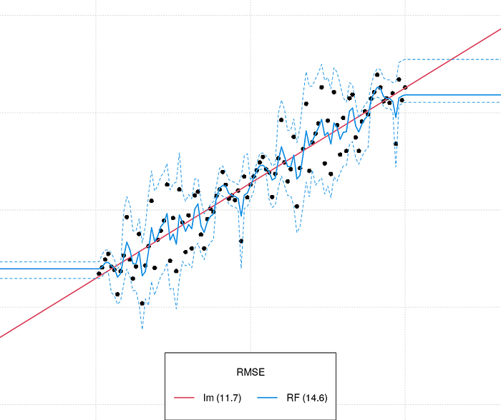
Random Forest – Regression Prediction Extrapolation
Prediction Phase:
For new values of PCP and TMP, each tree is evaluated
Results are averaged over all trees:
Qav = (2.1+1.9) / 2 Qav = 2m³/s
Random Forest does not extrapolate
https://medium.com/nerd-for-tech/extrapolation-is-tough-for-trees-tree-based-learners-combining-learners-of-different-type-makes-659187a6f58d

Slide 25
Random Forest – Testing
n=2000
Training
n=3000
Testing Phase:
For test values of PCP and TMP, each tree is evaluated
Results are averaged over all trees and compared to the Qav from the test dataset
n=1000
Testing
Qav=5.5m³/s
Qav=6.0 m³/s
Qav=2.3m³/s
Qav=6.4m³/s
Qav=2.0m³/s
Qav=6.5m³/s
PCP < 600mm/yr
PCP < 550mm/yr
TMP < 6°C
TMP < 8°C
TMP < 5°C
TMP < 9°C
Qav=2.5m³/s
Qav=2.1m³/s
Qav=6.7m³/s
Qav=6.0m³/s
Qav=2.4m³/s
Qav=1.9m³/s
Qav=6.9m³/s
Qav=5.8m³/s

Slide 26
Random Forest: Pros and Cons
Advantages:
Flexible in terms of problems for which it can be used
Performance vs. computational cost is good
Yields information about input variable (predictor) importance
Implemented in common programming languages (Python or R packages)
Disadvantages:
Predictions outside the training data range not possible
It can fit to noise in the data

Slide 27
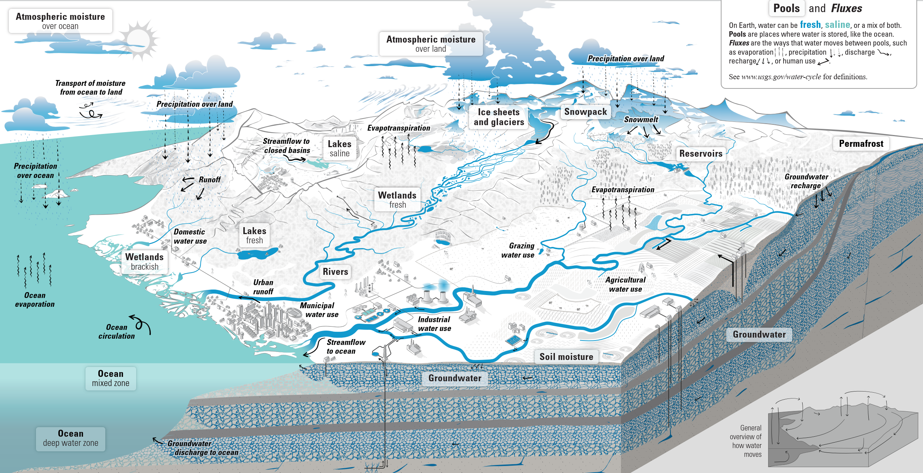
Content
Introduction
Quick overview of machine learning techniques
Random Forest and its pro’s and con’s
Random Forest for streamflow prediction
Data processing
Application of the algorithm
Performance assessment
Input data importance and prediction
Wrapping up
Lessons learned
Code example
Questions and Answers
Return flow to rivers
Modified from www.usgs.gov/water-cycle

Slide 28
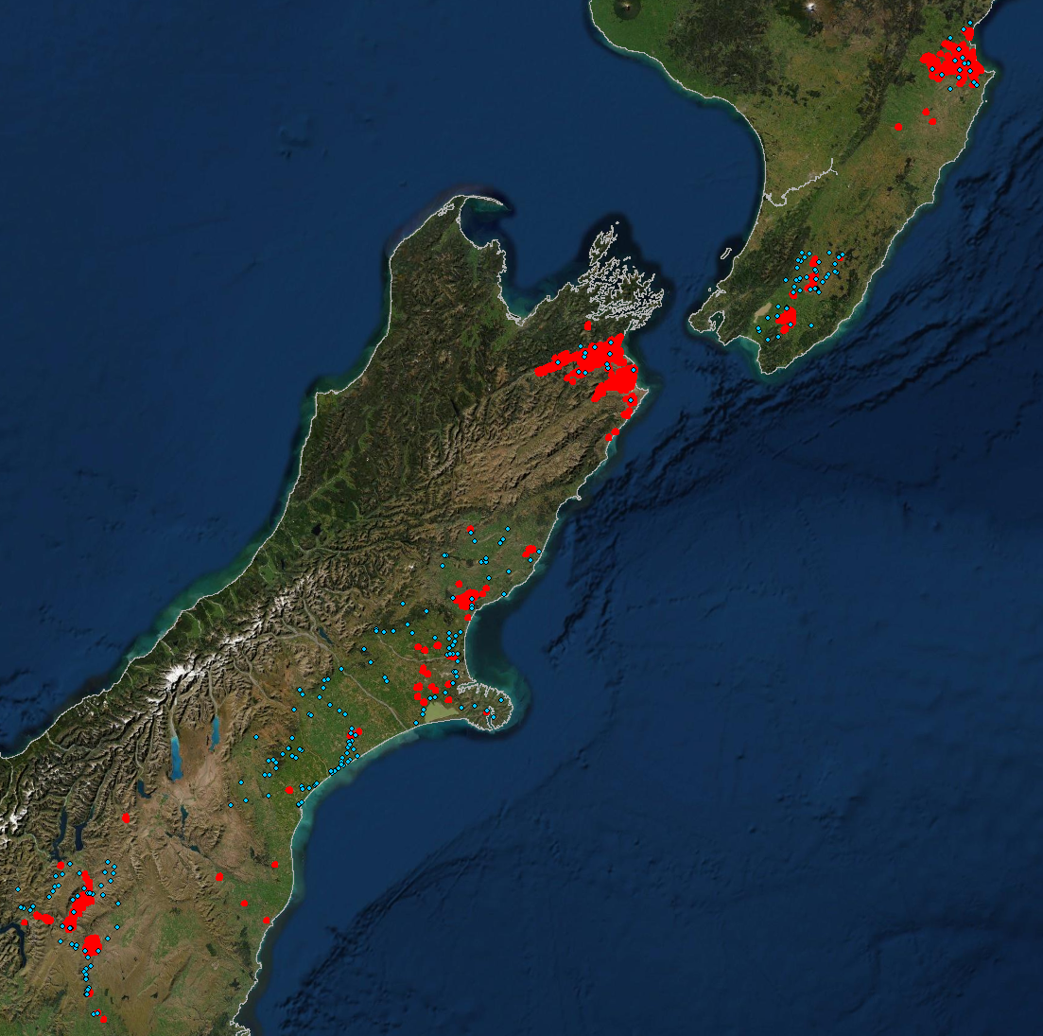
Aquatic Exposure Assessment for Pesticide Use
Assess impact on streams:
The 28-day Q90 (low flow) streamflow during application period is the target indicator
Streamflow observations not sufficient to directly estimate 28-day Q90 for application regions (red areas)
Spatial extrapolation based on selected gauge data (blue dots) required

Slide 29

Content
Introduction
Quick overview of machine learning techniques
Random Forest and its pro’s and con’s
Random Forest for streamflow prediction
Data processing
Application of the algorithm
Performance assessment
Input data importance and prediction
Wrapping up
Lessons learned
Code example
Questions and Answers
Pixabay | Gerd Altmann

Slide 30
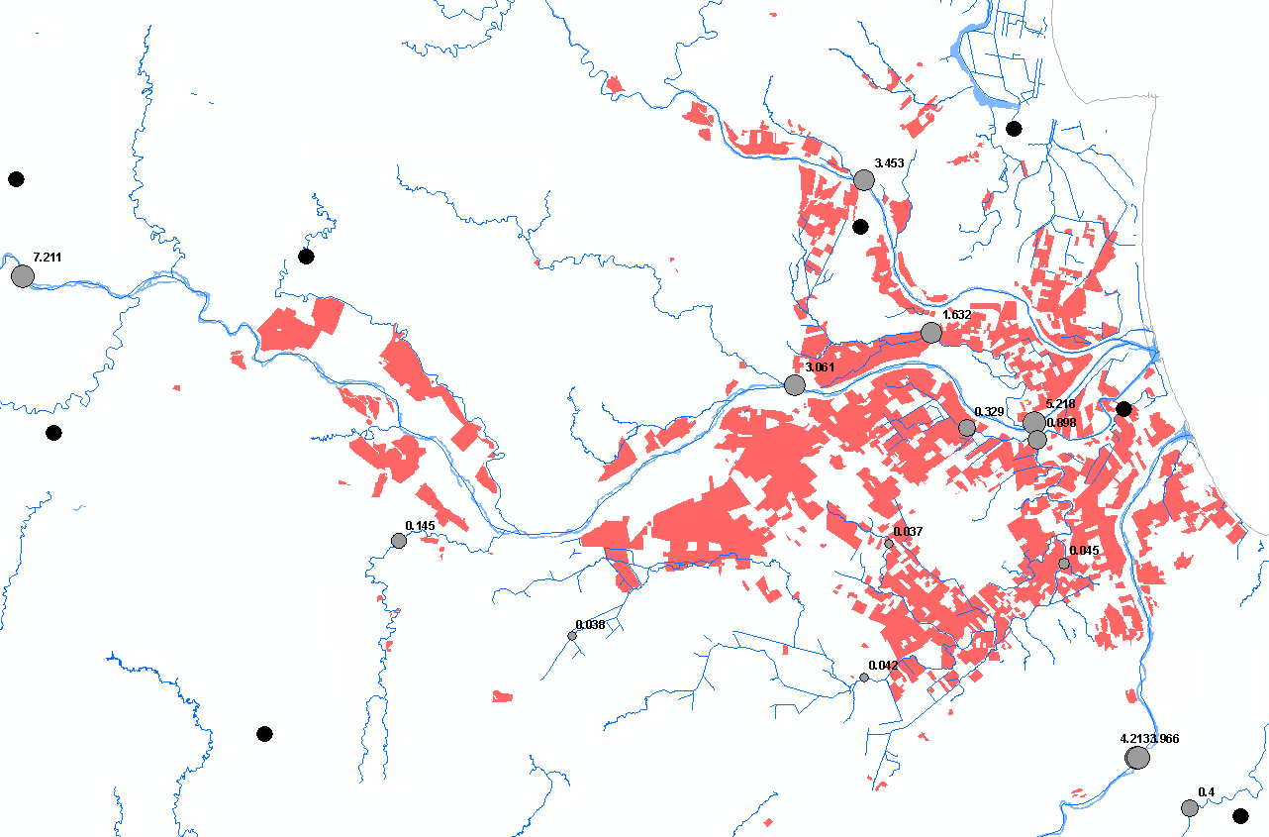
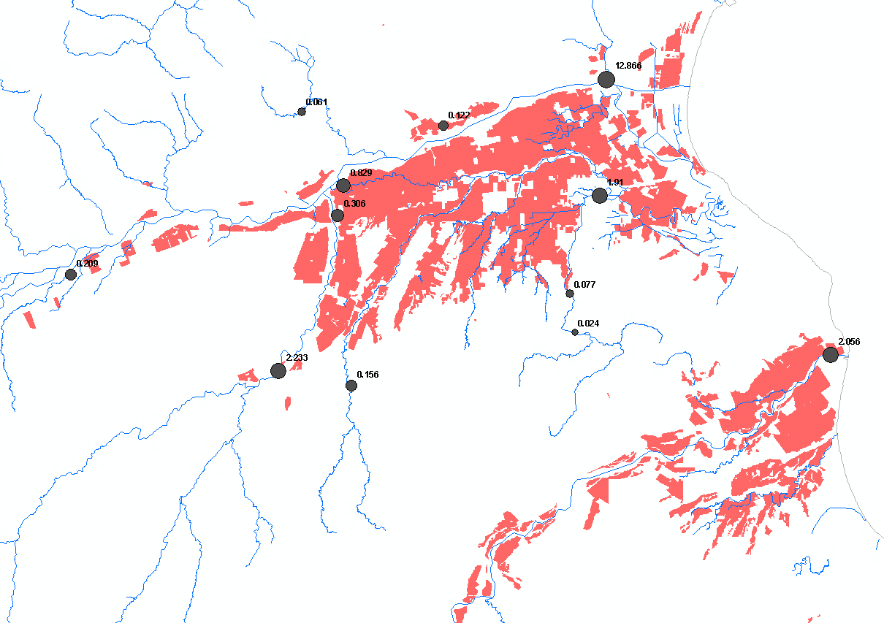
Target Variable Processing: Streamflow Metrics
Workarounds to deal with Random Forest extrapolation problem
Q90 values not extrapolating below lowest observations are problematic
Use a different method to extrapolate (e.g., linear regression) and add information to training data
Add ‘dummy’ zero-flow gauges at flow accumulation = 0
Used zero-flow gauges approach after testing
Application areas
Flow gauges with Q10
Dummy locations with zero flow

Slide 31
Target Variable Processing: Streamflow Metrics
Spatio-temporal time series processing
Compiling high-quality data from 476 gauge-based time series
Snap gauges to the DEM-derived stream network and calculate contributing areas
Manually check for implausible runoff rates and correct (n=28) or discard (n=27)
Calculate long-term average 28-day Q90 streamflow metrics during pesticide application period
Store 449 Q90 values and zero-flow values in a table
For plausibility check: Woods, R., Hendrikx, J., Henderson, R., & Tait, A. (2006). Estimating mean flow of New Zealand rivers. Journal of Hydrology (New Zealand), 45(2), 95–109. http://www.jstor.org/stable/43944944

Slide 32
Explanatory Variable Processing
Type | Variable | Nr. Files
Monthly climate | Actual evapotranspiration | 12
 | Long-term average monthly precipitation | 12
Soil data per layer | Bulk density of the fine earth fraction | 6
 | Volumetric fraction of coarse fragments | 6
 | Proportion of clay particles | 6
 | Soil Organic carbon density | 6
 | Proportion of sand particles | 6
 | Proportion of silt particles | 6
Land use | Cropland annual | 1
 | Cropland orchards | 1
 | Grassland high producing | 1
 | Grassland low producing | 1
 | Grassland with woody biomass | 1
 | Natural forest | 1
 | Other | 1
 | Planted forest pre1990 | 1
 | Planted forest post1989 | 1
 | Settlements | 1
 | Wetland vegetated non-forested | 1
 | Wetland open water | 1
Topography | Elevation | 1
 | Slope | 1
Spatial | y_coord | 1
 | x_coord | 1
 | Area | 1
 | Random | 1
Collection of variables known to influence streamflow
GIS processing
Calculate average variable value per contributing gauge area
Accumulate variable along flow accumulation (TauDEM’s contributing area tool with weight grid) (used after testing)
Add a random variable (explanatory variable with random values)
Extract data from spatial layers at gauge location (train/test) and add to the table
Topography: https://lris.scinfo.org.nz/layer/48131-nzdem-north-island-25-metre/
Climate: https://dataverse.harvard.edu/dataset.xhtml?persistentId=doi:10.7910/DVN/ZGOUED
Soil: https://ecodiv.earth/post/downloading-soilgrid-data/
Land Use: https://data.mfe.govt.nz/layer/52375-lucas-nz-land-use-map-1990-2008-2012-2016-v008/

Slide 33
Explanatory Variable Processing
Type | Variable | Nr. Files
Monthly climate | Actual evapotranspiration | 12
 | Long-term average monthly precipitation | 12
Soil data per layer | Bulk density of the fine earth fraction | 6
 | Volumetric fraction of coarse fragments | 6
 | Proportion of clay particles | 6
 | Soil Organic carbon density | 6
 | Proportion of sand particles | 6
 | Proportion of silt particles | 6
Land use | Cropland annual | 1
 | Cropland orchards | 1
 | Grassland high producing | 1
 | Grassland low producing | 1
 | Grassland with woody biomass | 1
 | Natural forest | 1
 | Other | 1
 | Planted forest pre1990 | 1
 | Planted forest post1989 | 1
 | Settlements | 1
 | Wetland vegetated non-forested | 1
 | Wetland open water | 1
Topography | Elevation | 1
 | Slope | 1
Spatial | y_coord | 1
 | x_coord | 1
 | Area | 1
 | Random | 1
Collection of variables known to influence streamflow
GIS processing
Calculate average variable value per contributing gauge area
Accumulate variable along flow accumulation (TauDEM’s contributing area tool with weight grid) (used after testing)
Add a random variable (explanatory variable with random values)
Extract data from spatial layers at gauge location (train/test) and add to the table
Extract data from spatial layers where predictions are needed to a second table
Topography: https://lris.scinfo.org.nz/layer/48131-nzdem-north-island-25-metre/
Climate: https://dataverse.harvard.edu/dataset.xhtml?persistentId=doi:10.7910/DVN/ZGOUED
Soil: https://ecodiv.earth/post/downloading-soilgrid-data/
Land Use: https://data.mfe.govt.nz/layer/52375-lucas-nz-land-use-map-1990-2008-2012-2016-v008/

Slide 34
Explanatory Variable Processing
Type | Variable | Nr. Files
Monthly climate | Actual evapotranspiration | 12
 | Long-term average monthly precipitation | 12
Soil data per layer | Bulk density of the fine earth fraction | 6
 | Volumetric fraction of coarse fragments | 6
 | Proportion of clay particles | 6
 | Soil Organic carbon density | 6
 | Proportion of sand particles | 6
 | Proportion of silt particles | 6
Land use | Cropland annual | 1
 | Cropland orchards | 1
 | Grassland high producing | 1
 | Grassland low producing | 1
 | Grassland with woody biomass | 1
 | Natural forest | 1
 | Other | 1
 | Planted forest pre1990 | 1
 | Planted forest post1989 | 1
 | Settlements | 1
 | Wetland vegetated non-forested | 1
 | Wetland openwater | 1
Topography | Elevation | 1
 | Slope | 1
Spatial | y_coord | 1
 | x_coord | 1
 | Area | 1
 | Random | 1
Working with categorical variables
Random Forest regression tries to relate consecutive IDs to target variable even though there is no relation (ordinal vs nominal relationship)
Encode categorical variables (see Code example):
“one-hot-encoding”: one column per category (used here)
“target encoding”: mean of target variable per category *
“frequency encoding”: number of occurrences per category
* Beware of the absent levels problem – then use a principal coordinates analysis (Smith HL, Biggs PJ, French NP. et al. (2024) Lost in the Forest: Encoding categorical variables and the absent levels problem. Data Min Knowl Disc. https://doi.org/10.1007/s10618-024-01019-w)

Slide 35
The Resulting Training and Testing Dataset
One table with 449 rows (gauge locations)
Target variable: 90th percentile of discharge during application period
Predictor variables: Accumulated explanatory variable value at gauge location
Q90 [m³/s] | Clay | Grassland | Natural Forest | PCP Nov | Other LU | Sand | Slope | PCP Jan | … | Wetland/OW
0.67 | 24654784 | 8384 | 3347 | 64441056 | 52 | 66119876 | 706932 | 8701797 | … | 1104
1.175 | 76954792 | 21206 | 46265 | 186890224 | 2962 | 169538048 | 5323731 | 31977644 | … | 1299
… | … | … | … | … | … | … | … | … | … | …
0.76 | 23532512 | 2229 | 31 | 54733364 | 0 | 57456076 | 618410 | 6435671 | … | 432

Slide 36
The Prediction Dataset
One table with n-rows (n=number of grid cells with prediction locations)
Target variable: No data
Predictor variables: Accumulated explanatory variable value at prediction location
Q90 [m³/s] | Clay | Grassland | Natural Forest | PCP Nov | Other LU | Sand | Slope | PCP Jan | … | Wetland/OW
 | 4654784 | 384 | 347 | 4441056 | 2 | 6119876 | 6932 | 701797 | … | 104
 | 954792 | 206 | 265 | 6890224 | 62 | 9538048 | 23731 | 977644 | … | 99
 | … | … | … | … | … | … | … | … | … | …
 | 32512 | 29 | 8 | 33364 | 0 | 56076 | 6410 | 5671 | … | 32

Slide 37
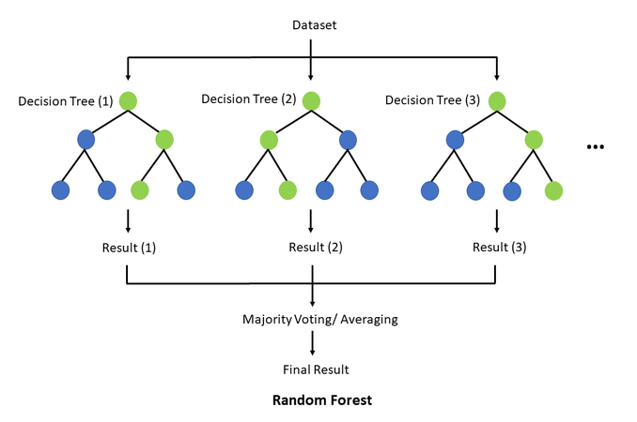
Content
Introduction
Quick overview of machine learning techniques
Random Forest and its pro’s and con’s
Random Forest for streamflow prediction
Data processing
Application of the algorithm
Performance assessment
Input data importance and prediction
Wrapping up
Lessons learned
Code example
Questions and Answers
Wikimedia Commons | TseKiChun

Slide 38
Random Forest Regression: Training Phase
Read train/test dataset to table
Sensitivity analysis of hyperparameters as combinations of
Number of trees
Random seeds
Depth of trees (optional)
Iterative training and testing using k-fold validation
dataset is split k-times and Random Forest is trained for each split – all data are used for training and testing
higher k increases computational costs but the more data is used for training
k can vary from two to number of samples (but typically in the range of ≤12)
Assess fit and plausibility per sensitivity combination
Average r² or RMSE or other suitable performance metric
Average variable importance – remove variables less important than random variable
Run best hyperparameter settings and selected explanatory variables for extrapolation
See Code example

Slide 39

Content
Introduction
Quick overview of machine learning techniques
Random Forest and its pro’s and con’s
Random Forest for streamflow prediction
Data processing
Application of the algorithm
Performance assessment
Input data importance and prediction
Wrapping up
Lessons learned
Code example
Questions and Answers
Pixabay | CutiePie

Slide 40
Streamflow Model Validation
Comparing Random Forest with regression-based approaches
Performance metric: r against the 1:1 line
Random Forest performed best overall, particularly for low flows
Q90 Q50 Q10
Q90 Q50 Q10
Q90 Q50 Q10
Q90 Q50 Q10

Slide 41

Content
Introduction
Quick overview of machine learning techniques
Random Forest and its pro’s and con’s
Random Forest for streamflow prediction
Data processing
Application of the algorithm
Performance assessment
Input data importance and prediction
Wrapping up
Lessons learned
Code example
Questions and Answers
Pixabay | Franganillo

Slide 42
Variable Importance
Average importance (percent) | Predictors (higher Random Variable)
11.3 | Natural Forest
10.6 | PCP May
9.9 | Wetland Openwater
8.5 | Other Landuse
7.8 | PCP Oct
7.4 | Grassland with woody biomass
5.9 | PCP June
5.7 | PCP Aug
5.7 | PCP Jan
4.7 | PCP Sep
4.4 | PCP Nov
3.7 | Organic Carbon 15-30cm
3.5 | SlopePercent
3.4 | PCP Jul
3.2 | PCP Apr
2.6 | Clay 0-5cm
1.9 | Sand 30-60cm
Only meaningful results if the model performs well
Consider removing highly correlated variables
Two approaches possible (see Code example)
Default feature importance: error reduction along the tree during training (used here)
Permutation importance: error increase when shuffling feature values during testing (compu-tationally expensive, less prone to overfitting)
Random variable is used to select ‘suitable’ predictors (all predictors with less importance than the random variable are excluded)
Land use and precipitation are the most important predictors, particularly forest and precipitation in May drive low flows during the application period (November to March)

Slide 43
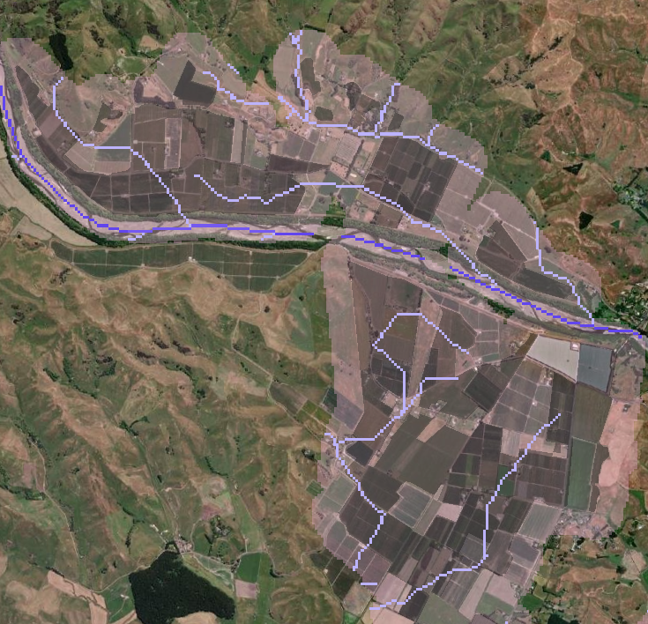
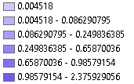
Random Forest Regression: Prediction Phase
Read prediction dataset to table
Provide table to trained model and run prediction
Map the predicted Q90 streamflow value to each 25m stream cell
Spatially cut the stream network at 250m buffer around application areas
In the example shown, a river passes the application areas
Application area
250m spray drift buffer

Slide 44

Content
Introduction
Quick overview of machine learning techniques
Random Forest and its pro’s and con’s
Random Forest for streamflow prediction
Data processing
Application of the algorithm
Performance assessment
Input data importance and prediction
Wrapping up
Lessons learned
Code example
Questions and Answers
Pixabay | ColiN00B

Slide 45
Take-Home-Messages
Summary
We used the Random Forest regression algorithm for a supervised learning problem
Random Forest
is computationally efficient, easy to learn and performs well
can’t extrapolate, requires hyperparameter tuning and validation
Explanatory (=predictor) variable importance can be used to understand processes and dependencies
Random Forest is implemented in common programming languages (Python or R packages)

Slide 46
Take-Home-Messages
Application of the algorithm
Level of effort for the streamflow example shown: around 40 hours - data preparation: ~50% - wrapping the Radnom Forest model into the workflow: ~20% - sensitivity analysis: ~15% - results analysis: ~15%
Computational requirements (8-core desktop PC): - Sensitivity analysis ~400 gauges with 17 predictors: up to multiple days - Learning ~400 gauges with 17 predictors: few minutes - Extrapolation (prediction) to 25m-raster (50% of NZ’s land area): ~1 hour
Just try it ☺

Slide 47
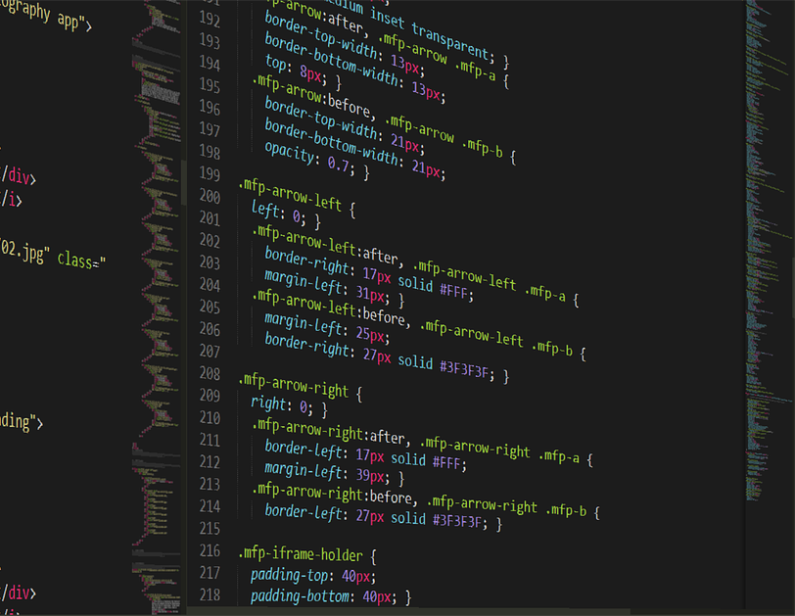
Content
Introduction
Quick overview of machine learning techniques
Random Forest and its pro’s and con’s
Random Forest for streamflow prediction
Data processing
Application of the algorithm
Performance assessment
Input data importance and prediction
Wrapping up
Lessons learned
Code example
Questions and Answers
Pixabay | Boskampi

Slide 48
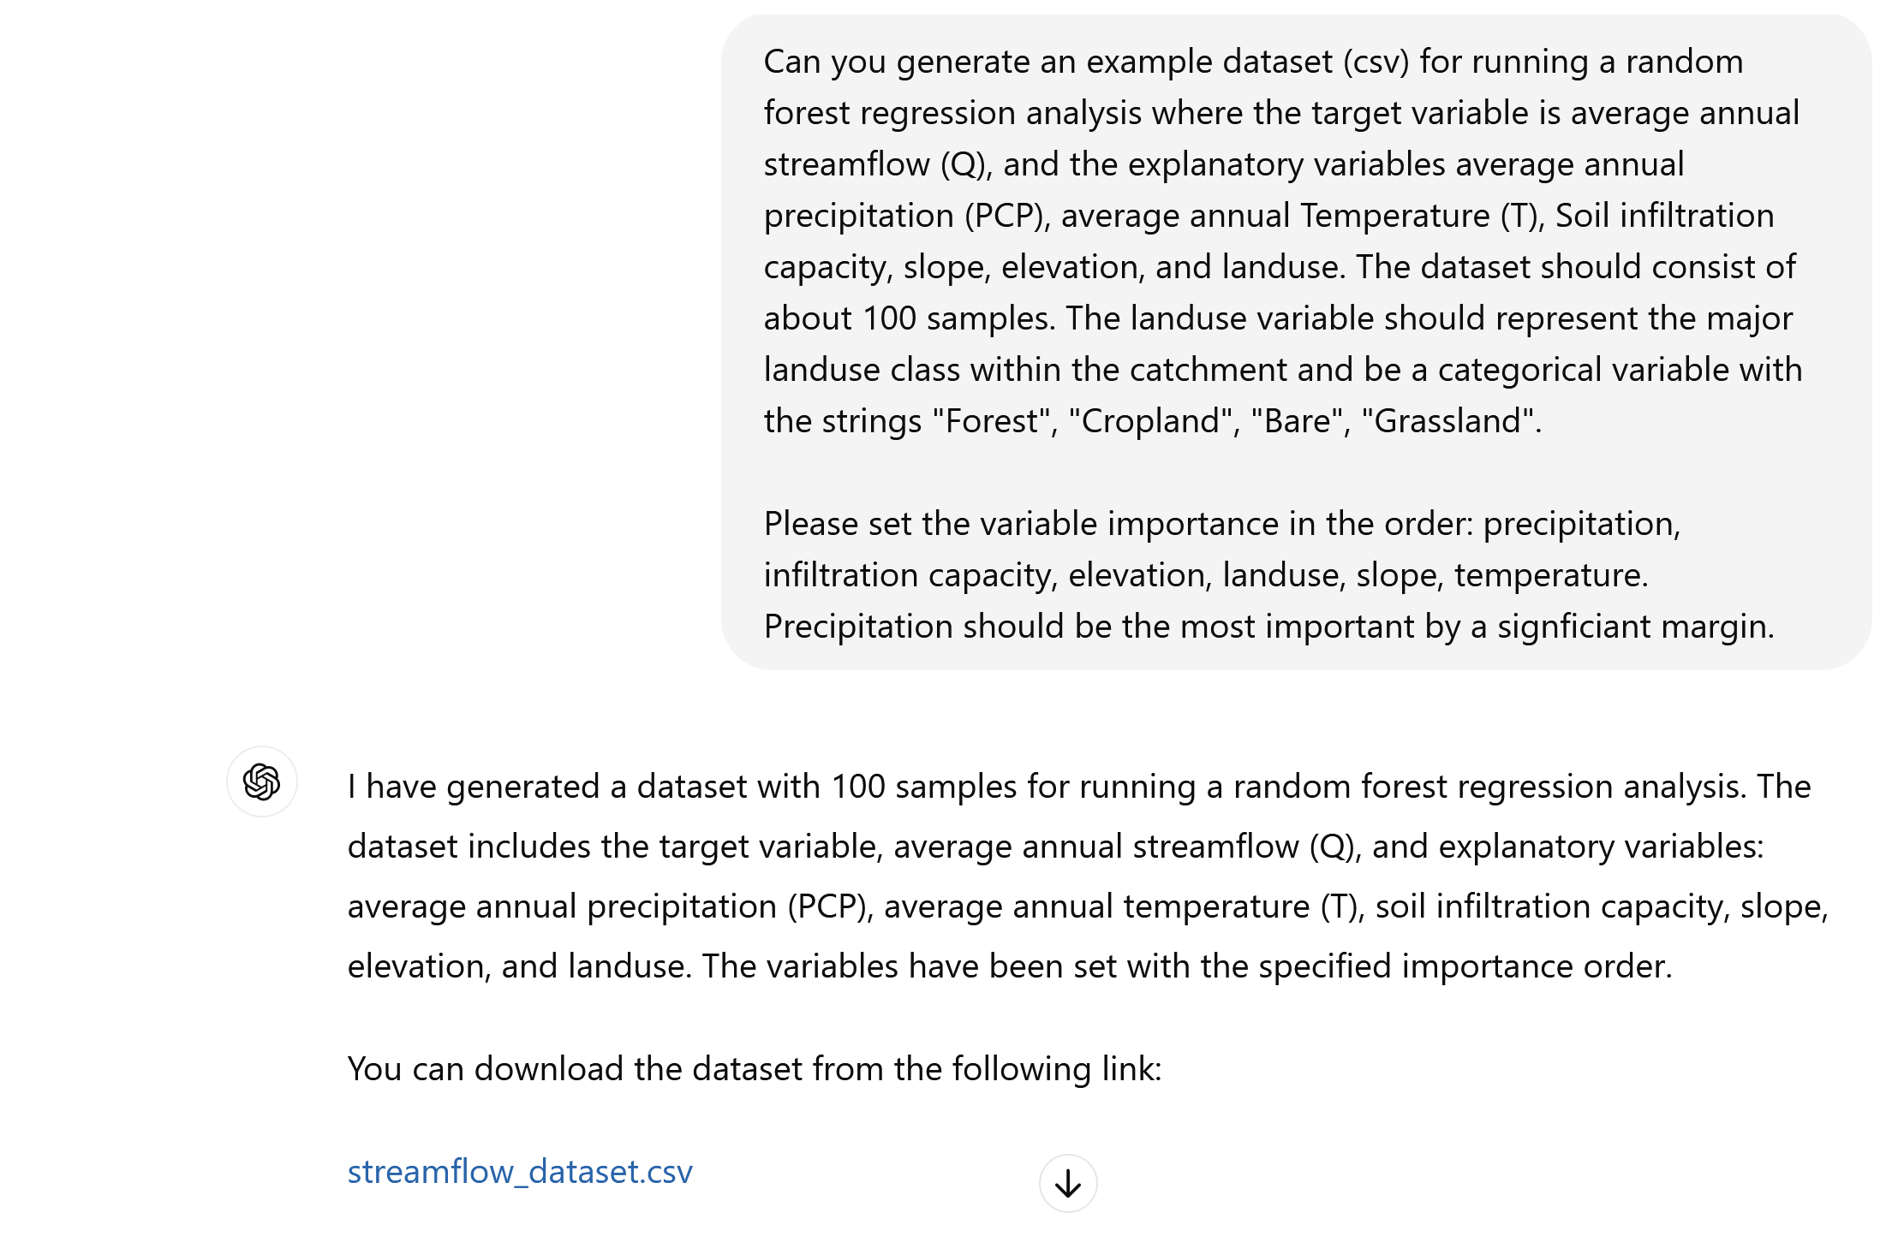
Code Example Available for Download
Provision of toy example and Python code
We could not share our data and therefore generated a dataset
Access the code and dataset: Link provided in the chat and on our webinar page on our website
Focus of the provided code lies on - sensitivity analyses of hyperparameters - model testing through k-fold validation - categorical variable encoding - investigating variable importance
GPT-4o generated dataset
https://chatgpt.com (GPT-4o)

Slide 49
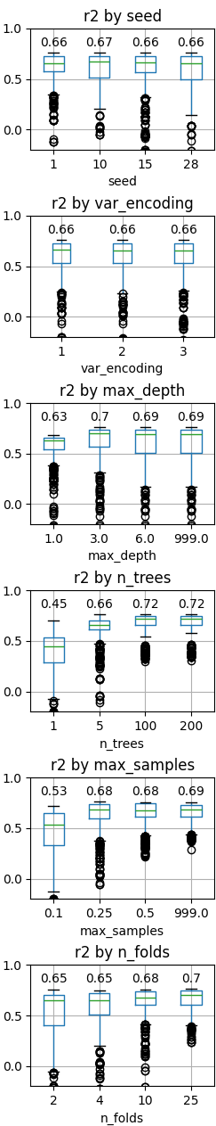
Sensitivity Test Results
Results from different seeds stable (variability due to low samples and trees)
Categorical variable encoding no impact: Landuse in the generated dataset seems to have too low importance
Tree depth of 1 is not sufficient, but with 3 decisions, the complexity of the dataset can be captured already
More trees improve the result, but level off at 100
Bootstrapping 50% of the samples seems sufficient
At least 10-fold validation is suggested

Slide 50
Variable Importance Results
r² < 0
If performance of model is low, variable importance is meaningless
Variable importance and permutation importance would lead to same conclusion in this example
Only precipitation and elevation are more important than the random variable ...we might have to give more detailed instructions to GPT-4o...
PredictorVariable | VarImp[%] | PermImp[%]
PCP | 50 | 52
Infiltration_Capacity | 0 | 0
Elevation | 0 | 0
Slope | 0 | 0
Temperature | 0 | 0
Forest | 0 | 0
Cropland | 0 | 0
Grassland | 0 | 0
Bare | 0 | 0
Random | 50 | 14.65
r² = 0.76
PredictorVariable | VarImp[%] | PermImp[%]
PCP | 84.41 | 144.68
Infiltration_Capacity | 2.9 | -0.13
Elevation | 3.88 | 0.86
Landuse | 0.84 | 0.81
Slope | 2.71 | 0.33
Temperature | 2.32 | -0.48
Random | 2.92 | 0.32

Slide 51



Slide 52

Content
Introduction
Quick overview of machine learning techniques
Random Forest and its pro’s and con’s
Random Forest for streamflow prediction
Data processing
Application of the algorithm
Performance assessment
Input data importance and prediction
Wrapping up
Lessons learned
Code example
Questions and Answers
Pixabay | Gerd Altmann

Slide 53
Thank you for your interest and attendance!
And make sure to check-out our future Webinars!
jkiesel@stone-env.com

Slide 54
Random Forest – Hyperparameters
Tailoring Random Forest to the dataset:
Number of trees:
more trees - higher “robustness” for higher computational cost
fewer trees - higher risk of overfitting
Considerations of default hyperparameter settings:
Default values enforce a certain degree of randomness
Reducing the number of sampling with replacement (i.e. 1000 instead of 2000) leads to trees that are less similar - more generalizable results but less training data used
Reducing depth/complexity/nodes/leaves – simpler trees are not prone to overfitting, but might not capture all complexity in the data
Large trees might fit to noise in the data
Test (hyperparameters and) number of trees for your datasets (see Code example)

Slide 55
General Note on Streamflow Predictions with Models
Conceptual Models:
Contain knowledge from centuries of hydrological research
Describe a simplified representation of reality
An experienced hydrological modeller knows approximate prediction uncertainties
Machine Learning Models:
Contain no knowledge – it is only an “empty” shell
Require as much data as possible to “catch up” with research
The flexibility of the models allows fitting to any (but also nonsense) data
High quality of training data, verification, and process understanding required

Slide 56
scikit-learn – Random Forest Regression kwarg’s
n_estimators=100: The number of trees in the forest. More trees can improve the model (reduces overfitting) but will also increase computation time.
criterion='squared_error': The function to measure the quality of a split (in classification it’s the Gini Impurity). A split has a higher quality if it has a low variance or SD. 'squared_error' calculates the mean squared error (difference to mean), which is common for regression tasks.
max_depth=None: The maximum depth of each tree. If None, nodes are expanded until all leaves are pure (=cannot be further split as they are unique, have all the same value) or contain fewer than min_samples_split samples. Lower tree depth result in more generalizeable trees, but might also lead to worse performance, but also less fitting to noise.
min_samples_split=2: The minimum number of (unique) samples required to split an internal node. A higher number can prevent overfitting.
min_samples_leaf=1: The minimum number of samples that a leaf node must have. Higher values prevent model from learning too much noise.
min_weight_fraction_leaf=0.0: The minimum weighted fraction of the input samples required to be at a leaf node. Useful for handling different sample weights (per default, weights are equal for all samples, but can be set differently if it is known that some samples are more important than others – e.g. a distance parameter could be used as weights in the ‘fit’ function kwarg “sample_weight”).
max_features=1.0: The number of features to consider when looking for the best split. This means that the algorithm randomly selects the number of max features (from all features in the dataset) and calculates the error criterion for all possible splits over all samples. Can be a fraction of the total number of features or an absolute number. Lower values can reduce overfitting.
max_leaf_nodes=None: The maximum number of leaf nodes in the forest. Smaller number of leaves reduces also the depth of the tree, reduces overfitting, results in trees that are easier to interpret and its computationally more efficient. If None, there is no limit on the number of leaf nodes.
min_impurity_decrease=0.0: A node will be split if this split induces a decrease in impurity greater than or equal to this value. This occurs during tree construction (unlike ccp_alpha which is evaluated after the tree is constructed). Larger values make the tree simpler and reduce overfitting.
bootstrap=True: Whether bootstrap samples are used when building trees. If False, the whole dataset is used to build each tree – same trees (no ensemble), overfitting, poor performance on unseen data (still, trees might be different due to randomness in max features, max leaves, etc)
oob_score=False: Whether to use out-of-bag samples to estimate the generalization accuracy. If bootstrap is True and max_samples is none, still about 1/3 of samples are available for oob. It is different to train/test because it is faster and the algorithm gets / sees the complete dataset. But it also means that no true ‘validation’ is possible. This can provide a more accurate estimate of the model's performance.
n_jobs=None: The number of jobs to run in parallel. None means 1 job, -1 means using all processors. (parallelized across trees)!
random_state=None: Controls the randomness of the bootstrapping and feature selection (and tie-breaking). Ensures reproducibility if a specific value is provided.
verbose=0: Controls the verbosity when fitting and predicting. 0 means no output, higher values increase the verbosity.
warm_start=False: Reuse the solution of the previous call to fit and add more estimators (trees) to the ensemble. Useful for iterative training.
ccp_alpha=0.0: Complexity parameter used for Minimal Cost-Complexity Pruning. It is applied after the tree is grown and nodes are removed to reduce tree complexity. Higher values make the tree simpler and reduce overfitting.
max_samples=None: If bootstrap is True, the number of samples to draw from X to train each base estimator. If None, draws len(X) samples. But statistically, it means (if bootstrapping is true) that 2/3 of samples are only considered, 1/3 is sampled twice) – so, on average 1/3 of samples are available for oob!
monotonic_cst=None: Constraints to enforce monotonicity on features. None means no constraints.
Overfitting: Is an issue if single trees grow too large and have too many leaves so that the split/difference between leaves comes down to noise/inaccuracies in the data – this is reduced if tree sizes are limited (e.g. Max_depth, min_samples_split, min_samples_leaf, max_features, max_leaf_nodes, min_impurity_decrease and ccp_alpha) –but this might also reduce the model's ability to capture complex patterns in the data; or if bootstrapping is True (then different trees are built based on slightly different input data)
Randomness: if random state is a number, bootstrapping and feature selection (and tie-breaking =if multiple features have the same impurity reduction) are the same for the same run – then each decision tree is deterministic. Because the random sampling is done WITH REPLACEMENT, bootstrapping with max_samples=None still leads (most likely) to a different subset of samples for each tree. Random forest tries to use the randomness multiple times. It is inherently built so that each tree is “random” to avoid overfitting.
Feature Importance: the importance of the input features is evaluated by the criterion (e.g. RMSE) – so the more a certain feature reduces the squared error through a split, the more important is the feature!

